Slide 1

Walmart Sales Tableau Dashboard Report
Presented By:
Harshita Gupta

Slide 2

Introduction
This dataset contains 51290 rows and 23columns.
This dataset contains columns i.e, order-id ,order date ,category ,sub-categories,ship mode, ship date, region, country ,city, sales ,profit,discount,quantity etc.
This dataset is taken from Kaggle.com.

Slide 3
Attributes Information
Order ID : Order's id
Order Date : On which date order is placed
Ship Mode : Shipping modes i.e, First class , Same day, Secondary class, Standard class.
Segment : i.e, Consumer, coperate ,home office.
Country : Order is taken from which country.
City: City from where order is placed.
Region: Region from where order is placed.

Slide 4
To be continued…
Quantity: Number of products purchased by customer.
Product ID: Id on which product is purchased
Product Name: Name of the product.
Sales: Sales on the product purchased by the customer.
Discount: Discount on the product.
Category: Some categoried are defined.
Order Priority: i.e, Medium, High, Crtical or Low.

Slide 5
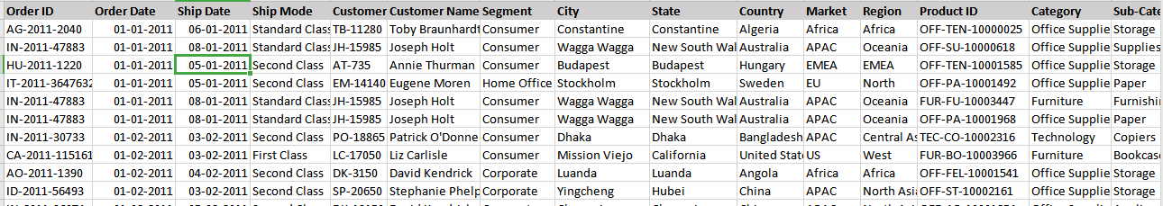
Data

Slide 6
Problem Statements
Region wise Profit and Sales Trend
Product wise Sales
Top and Bottom Sub-Categories
Country wise Sales
Shipping Mode Categories

Slide 7
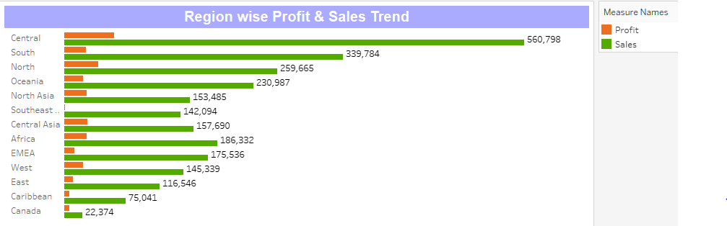
Executive Summary
1. Region wise Profit and Sales Trend

Slide 8
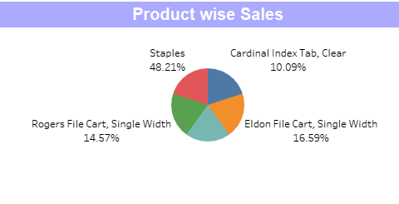
2. Product wise Sales

Slide 9
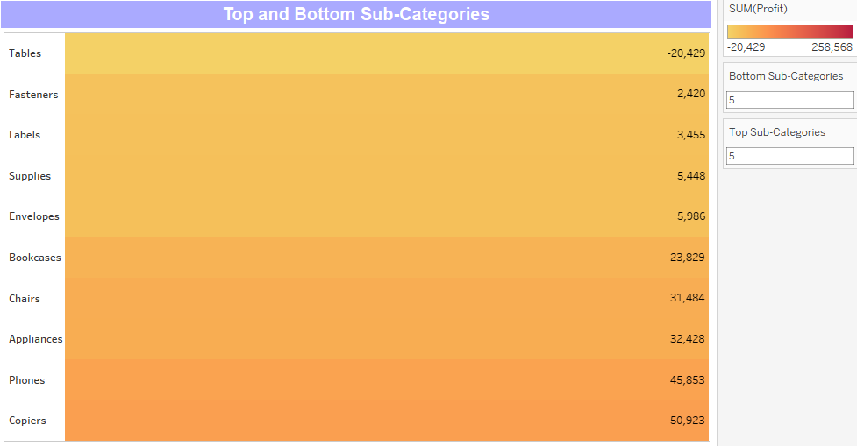
3.Top and Bottom Sub-Categories

Slide 10
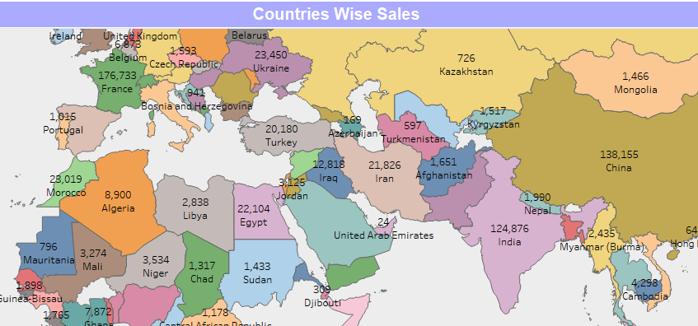
4.Country wise Sales

Slide 11
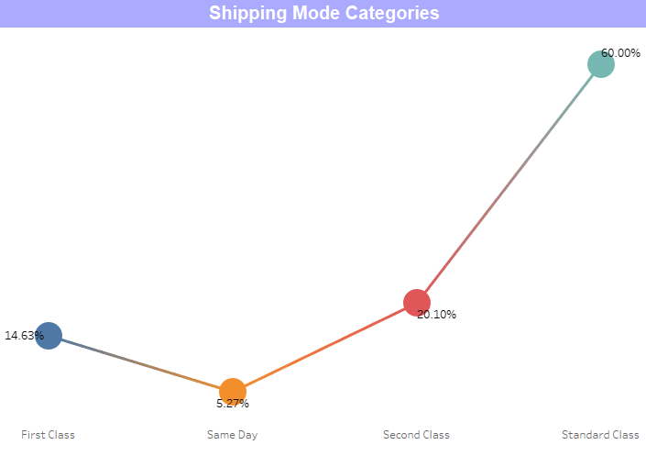
5.Shipping Mode Categories

Slide 12
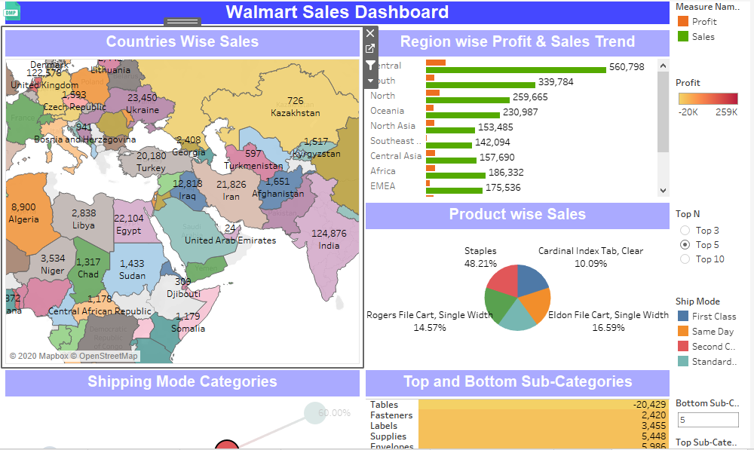
Final Dashboard

Slide 13
Conclusion
Walmart's highest profit with respect to sales is in the region of Central and lowest is in Canada. Hence company should focus more on sales in Canada.
And also Walmart's lowest sale with respect to sub-categories is for tables and this tends to heavy loss. Hence company should focus and recover this loss.
Link for the video: https://drive.google.com/open?id=1yQX69z1mrsUJ4o81ig4j2DWqHw4L7IyA

Slide 14

Thank You

